Slide 1
Arrowhead Framework development coordination:
21-05-11 at 15.30
Meeting link:
https://ltu.webex.com/ltu/j.php?MTID=m53372c08f6c7a095410d9b4fa3ee220f

Slide 2
Agenda
Major achievements Y2
New interoperability support and tools
How do we move from a coding project to a solution ecosystem?
Eclipse Arrowhead v5.0 roadmap, Jerker
Updates on release candidates SysML 1.6 profile & core system models - Jerker WorkflowManager/WorkflowExecutor, Jaime, TestTool, Hans Sandboxing tool, Hans C++ of v4.2
Updates to prototypes Code generation from SysML, Saadia Consumer code generation, Cristina PlantDescription, Olov/Johan ExchangeNetwork, Ulf/Emanuel Autonomic orchestration/configuration, An Security mitigation tool, Silia Security compliance test, Ani Vorto, Hono and Hawkbit, Johannes ESB, CPN, NodeRed, Felix Translation - Semantics, Jacob SysML2 - profile, Oystein/Geza/Jerker C# and .net library Safety Manager, Mirren/Daniela (on-hold) Kura and Kapua, Paolo
Updates on engineering Engineering process, Jan/Gianvito Engineering tool chain, Marek/Federico Engineering tools, Hans/Pal
Updates on training Training, HW, SW, literature, Mattheui/Emmanuel/Mats Training tool, Sebastian/Marcello/Saadia
Next telco May 25 Feature contributions: PlantDescription - User authentication, Feidor

Slide 3
MoM
Sign up for the Eclipse Arrowhead mailing list arrowhead-dev@eclipse.org at https://accounts.eclipse.org/mailing-list/arrowhead-dev
MoM at www.github.com/exclipse-arrowhead/roadmap

Slide 4
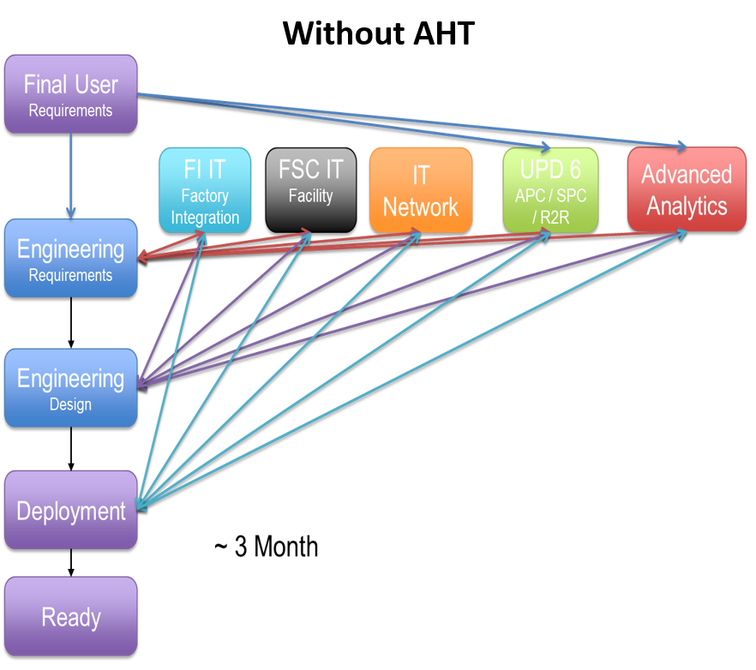
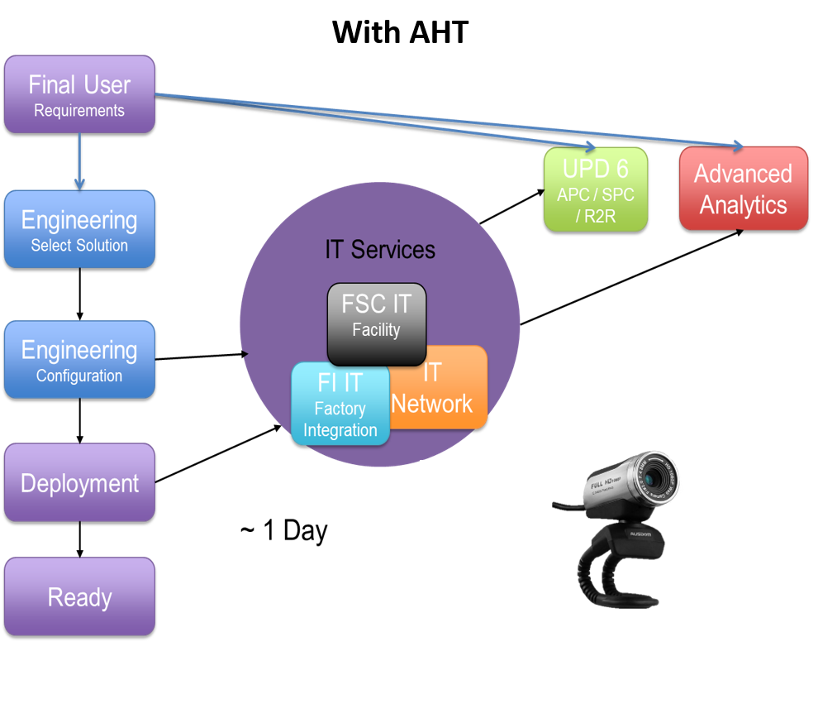
Sub Subtask 9.4.2, Sub Use Case 16.2: “I/O- Link and sensor fusion”

Slide 5
Subtask 9.4.5, Sub Use Case 16.4: “Smart Maintenance”
By using the Arrowhead IoT Framework, automated vibration monitoring of the entire transport system is possible for the first time. The implementation saves significant time and money, while providing the interface to reuse both hardware and software components. Users benefit from the reduced complexity of the process and the informative and easy-to-understand visualizations. Due to the automation of the process, the time required to perform a measurement run was reduced from two hours to 20 to 30 minutes (see Figure 41, left). This represents an improvement of 83%. In addition to this significant economic factor, the number of people who can carry out a measurement run from a technical, professional and physical point of view has also been increased. Previously, only an engineer with expertise in computer science, data processing and vibration analysis could carry out a measurement run.

Slide 6
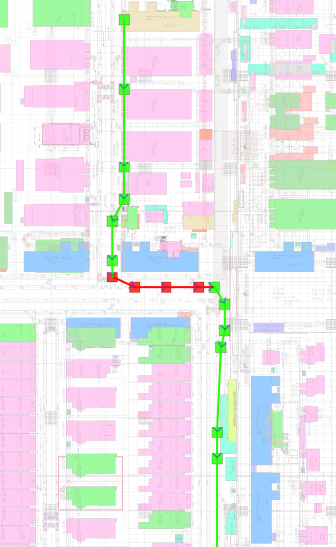
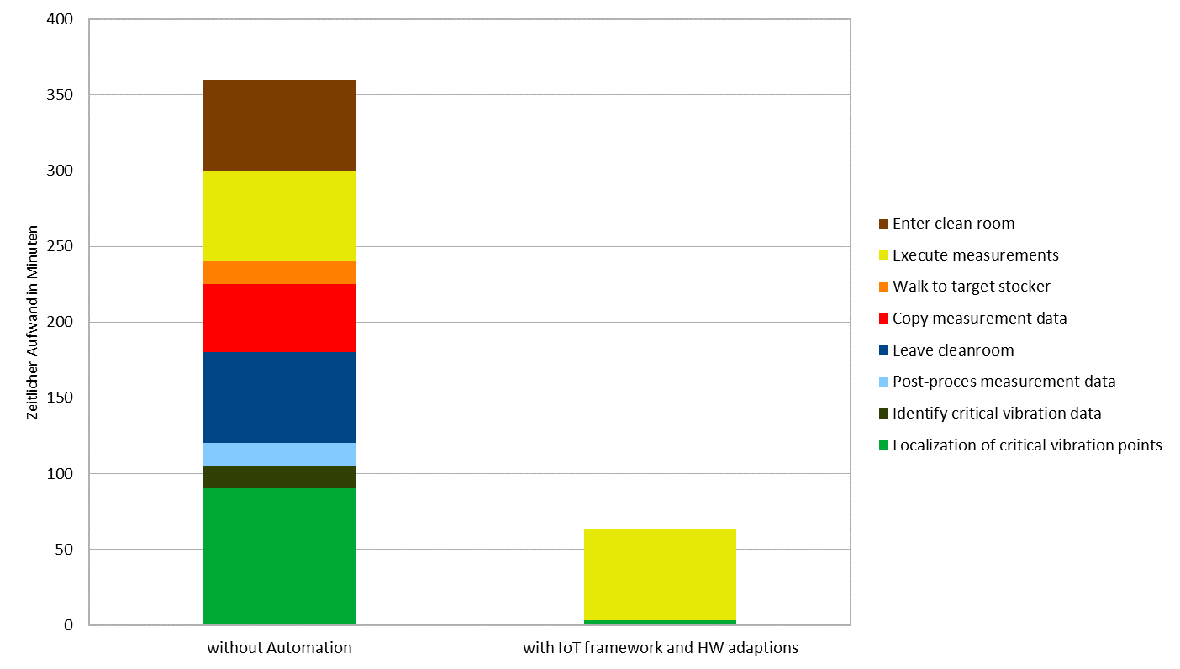

Slide 7
Task 9.7, Sub Use Cases of Use Case 8: SoS engineering of IT edge devices
Sub use case 8.1 - Integration of Vital in Eclipse Arrowhead
In the absence of the integration interface with AHT framework, the vital-IoT end-users were ought to perform the integration of the new information providers manually.
While with the presence of an integration interface with AHT, the whole process of subscribing to the new information providers takes less than a few seconds
Delta% = [(Total TMU B-AHT - Total TMU A-AHT) / Total TMU B-AHT] * 100 = 0.96 * 100 = 96%
Using the AHT platform, in Vital-IOT, our LEGACY Tool, we have completely removed the phase of sensors and services integration which were done by the manual installation.

Slide 8
Main Process | Subprocesses | Time in seconds | Total time in seconds | Time in TMU | Total time in TMU
Modifications on the server application’s configuration | Finding the Wildfly standalone.xml file Finding the first required section Deleting the previous text Adding the text Finding the second required section Deleting the previous text Adding the text Saving and exiting Starting the server | 60 sec 60 sec 10 sec 20 sec 60 sec 10 sec 20 sec 2 sec 180 sec | 422 | 1666.66 1666.66 277.77 555.55 1666.66 277.77 555.55 55.55 5000 | 11722.22
Repository Cloning | Writing the git clone command Cloning process | 60 sec 240 sec | 300 | 1666.66 6666.66 | 8333.33
Installing the packages | Writing the command Installation process | 10 sec 300 sec | 310 | 277.77 8333.33 | 8611.11
Transferring the files to the server application | Copying the .war file Finding the server application folder Pasting the .war file | 5 sec 60 sec 10 sec | 75 | 138.88 1666.66 277.77 | 2083.33
Restarting the server application | Writing the command to stop the application server Stoppage process Writing the command to start the application server Starting process | 5 sec 30 sec 5 sec 180 sec | 220 | 138.88 833.33 138.88 5000 | 6111.11
Total TMU |  |  | 1327 |  | 36861.11

Slide 9
Main Process | Subprocesses | Time in seconds | Total time in seconds | Time in TMU | Total time in TMU
Sending a request for desired services to Arrowhead Server | Clicking on the add button Writing the information about the service he/she is looking for Click on the send | 1 sec 10 sec 1 sec | 12 | 27.77 277.77 27.77 | 333.33
Finding the desired service in the response | Finding the desired services Marking the services he/she is interested in | 30 sec 10 sec | 40 | 833.33 277.77 | 1111.11
Saving the service to the configuration | Clicking on the save button | 1 sec | 1 | 27.77 | 27.77
Total TMU |  |  | 53 |  | 1472.22

Slide 10
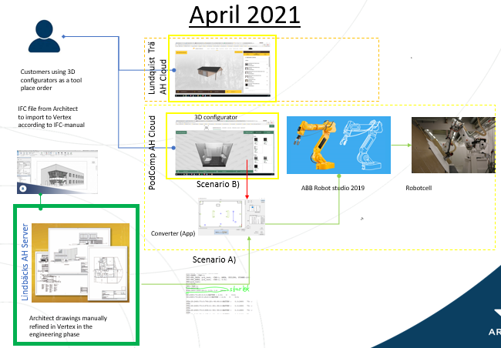
Task 8.4 Use Case: Production preparation tool chain integration
7 weeks
to
1 week

Slide 11
Task 8.9. Use Case: Data-based digital twin for electrical machine condition monitoring (UC21)
One of the key project objectives is reduction of solution engineering costs by 20-50%. This is targeted by developing and running the services based on open-source solutions and running integrated different tools and related services smoothly within Arrowhead Framework. During the early stages of the use case activities, digital twin model automatic build up via Rest API and noise analysis digital twin as well as gained improvement of the system efficiency. They were estimated to yield over 50 % cost reduction compared to the currently applied, original processes in the use case environment. Others were implementing necessary IoT and SoS architecture, interoperability of new and legacy tools, automation and security among others. Contributing steps to these are reported in D8.3.

Slide 12
1) New interoperability and tools
Arrowhead Framework connector for PREM compiler - CAMEA (extension of clang/LLVM) and scheduler is now available (https://github.com/CTU-IIG/ah-prem-sche
Shell to AH Framework - IKERLAN
EDGE MONITORING TOOL - REPLY Edgex microservices are installed on the gateway with K3S and so there’s the need to verify easily in every moment if all the microservices are working perfectly. For this purpose, the Edge Monitoring Tool is implemented. In order to get the health status of the microservices, Vital-IoT makes a request to the gateway with a predefined frequency of time. So a JSON message arrives on the MQTT broker on the topic “topic/service-status-req” that requires the status of the microservices. The Tool is subscribed to that topic and when the request arrives, it searches for the list of microservices available at that moment. When the Tool knows the name of the microservices, it recalls an Edgex API for every single microservices that returns the health status. Below, the health status is represented in the dashboard by a colorful circle. It’s green when microservice is up, red when is down; notice that some microservices don’t have a health API, so they are marked with a grey circle.
RoboFuse adaptors to be able to integrate it with AHT, - ROPARDO
RoboFuse Control Panel
Custom Integration
Stream Process When all these areas are completely functional from RoboFuse will be possible to, register RoboFuse as data provider for any AHT Instance, register end point where Robofuse can ingest data from AHT Instance.
Register an RoboFuse application and associated devices with AHT Authorization.
Publish device data from RoboFuse to the AHT Service Registry / Orchestrator
Publish RoboFuse ingest end points to the AHT Service Registry / Orchestrator
BEIA IoT tool - BEIA
NodRed based tool

Slide 13
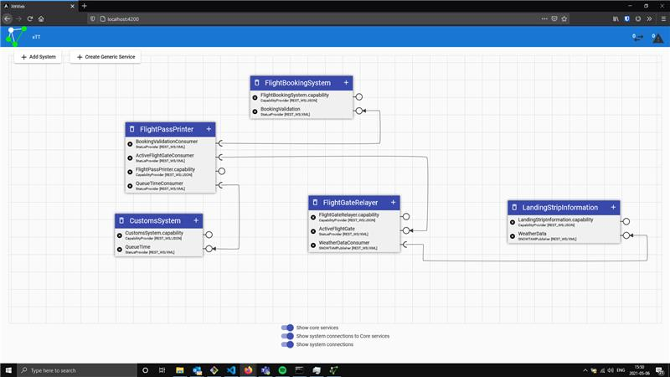
Test Tool
1 Implementing 2 new communication profiles
UPC-UA
MQTT
2 Meeting with Emanuel discussing technology for graphical presentation of System of Systems

